Slide 1

EC311 Final Project Presentation:
Whack-a-Mole
Kofi Frempong, Mingshan Guo, Arielle Maravilla, Jacob Nissenbaum, Mirclea Tan

Slide 2
Rubric Reference (Delete this Slide)
✅ Project title, project members – this should be a single slide
✅ Goal/Motivation –what you are doing and why. This slide should include 1 concrete example of how someone could actually use your design in real life.
✅ Short Functionality – one slide max recapping what you are doing. What was your design supposed to do?
✅ Short Specification – one slide max recapping the specification of the design. What were the requirements? Constraints?
✅ Detailed Block Diagrams – provide the real block diagrams for your design.
Code Snippet – provide 1 or 2 of your best code snippets and discuss. What was unique about it? Challenging? Innovative?
✅Successes – discuss how your project was successful and why.
Failures – discuss how your project did not work out as you planned. Provide examples of what you would do differently.

Slide 3
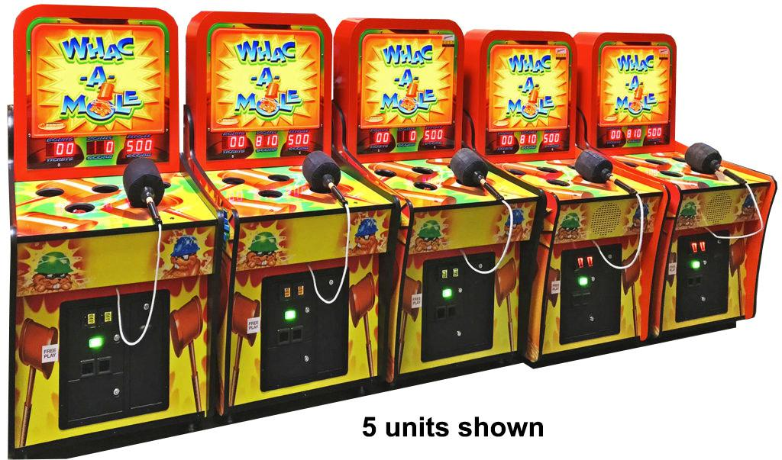
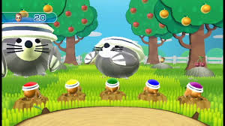
We made Whack-a-Mole on an FPGA. Someone could use this as entertainment…

Slide 4
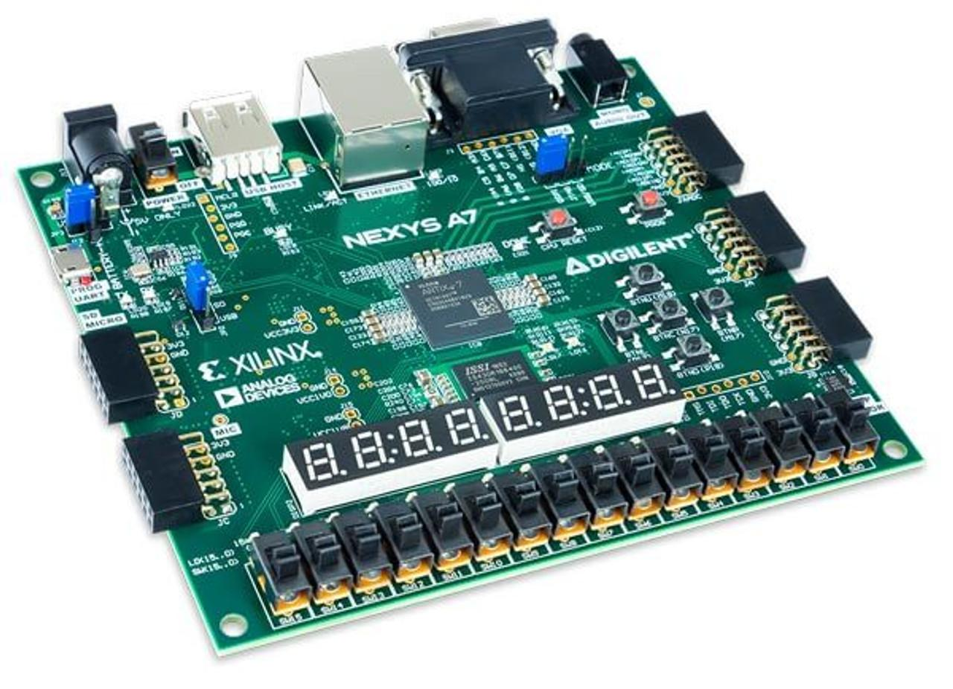

Think of it like an arcade cabinet; you press the button to start the game, the visuals of the game are displayed on the monitor. You interface with the game with the fpga (swing it)

Slide 5
An idea of what this could look like…
:)

Slide 7
Also, some box-art…

Slide 8
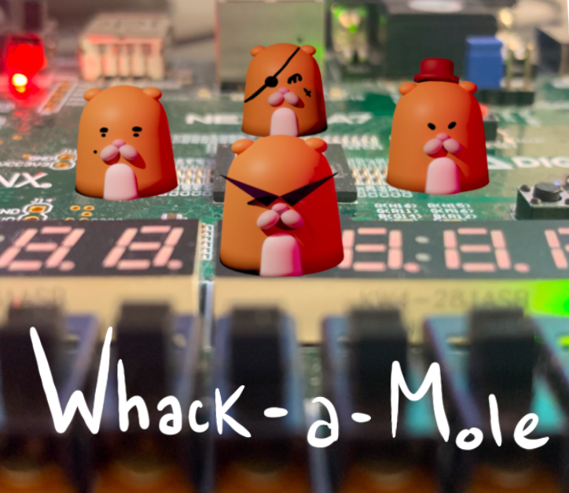


Slide 9
Specifications:
Requirements and Constraints
Implement a Random Number Generator to set time between mole appearances between 1-3 seconds with variability
1 second window to hit mole for points, decreasing with score
1:1 “whack” (via button/motion) per mole
Reset Switch for resetting statistics (e.g. lives, score)

Slide 10
Block Diagram & Game Logic

Slide 11
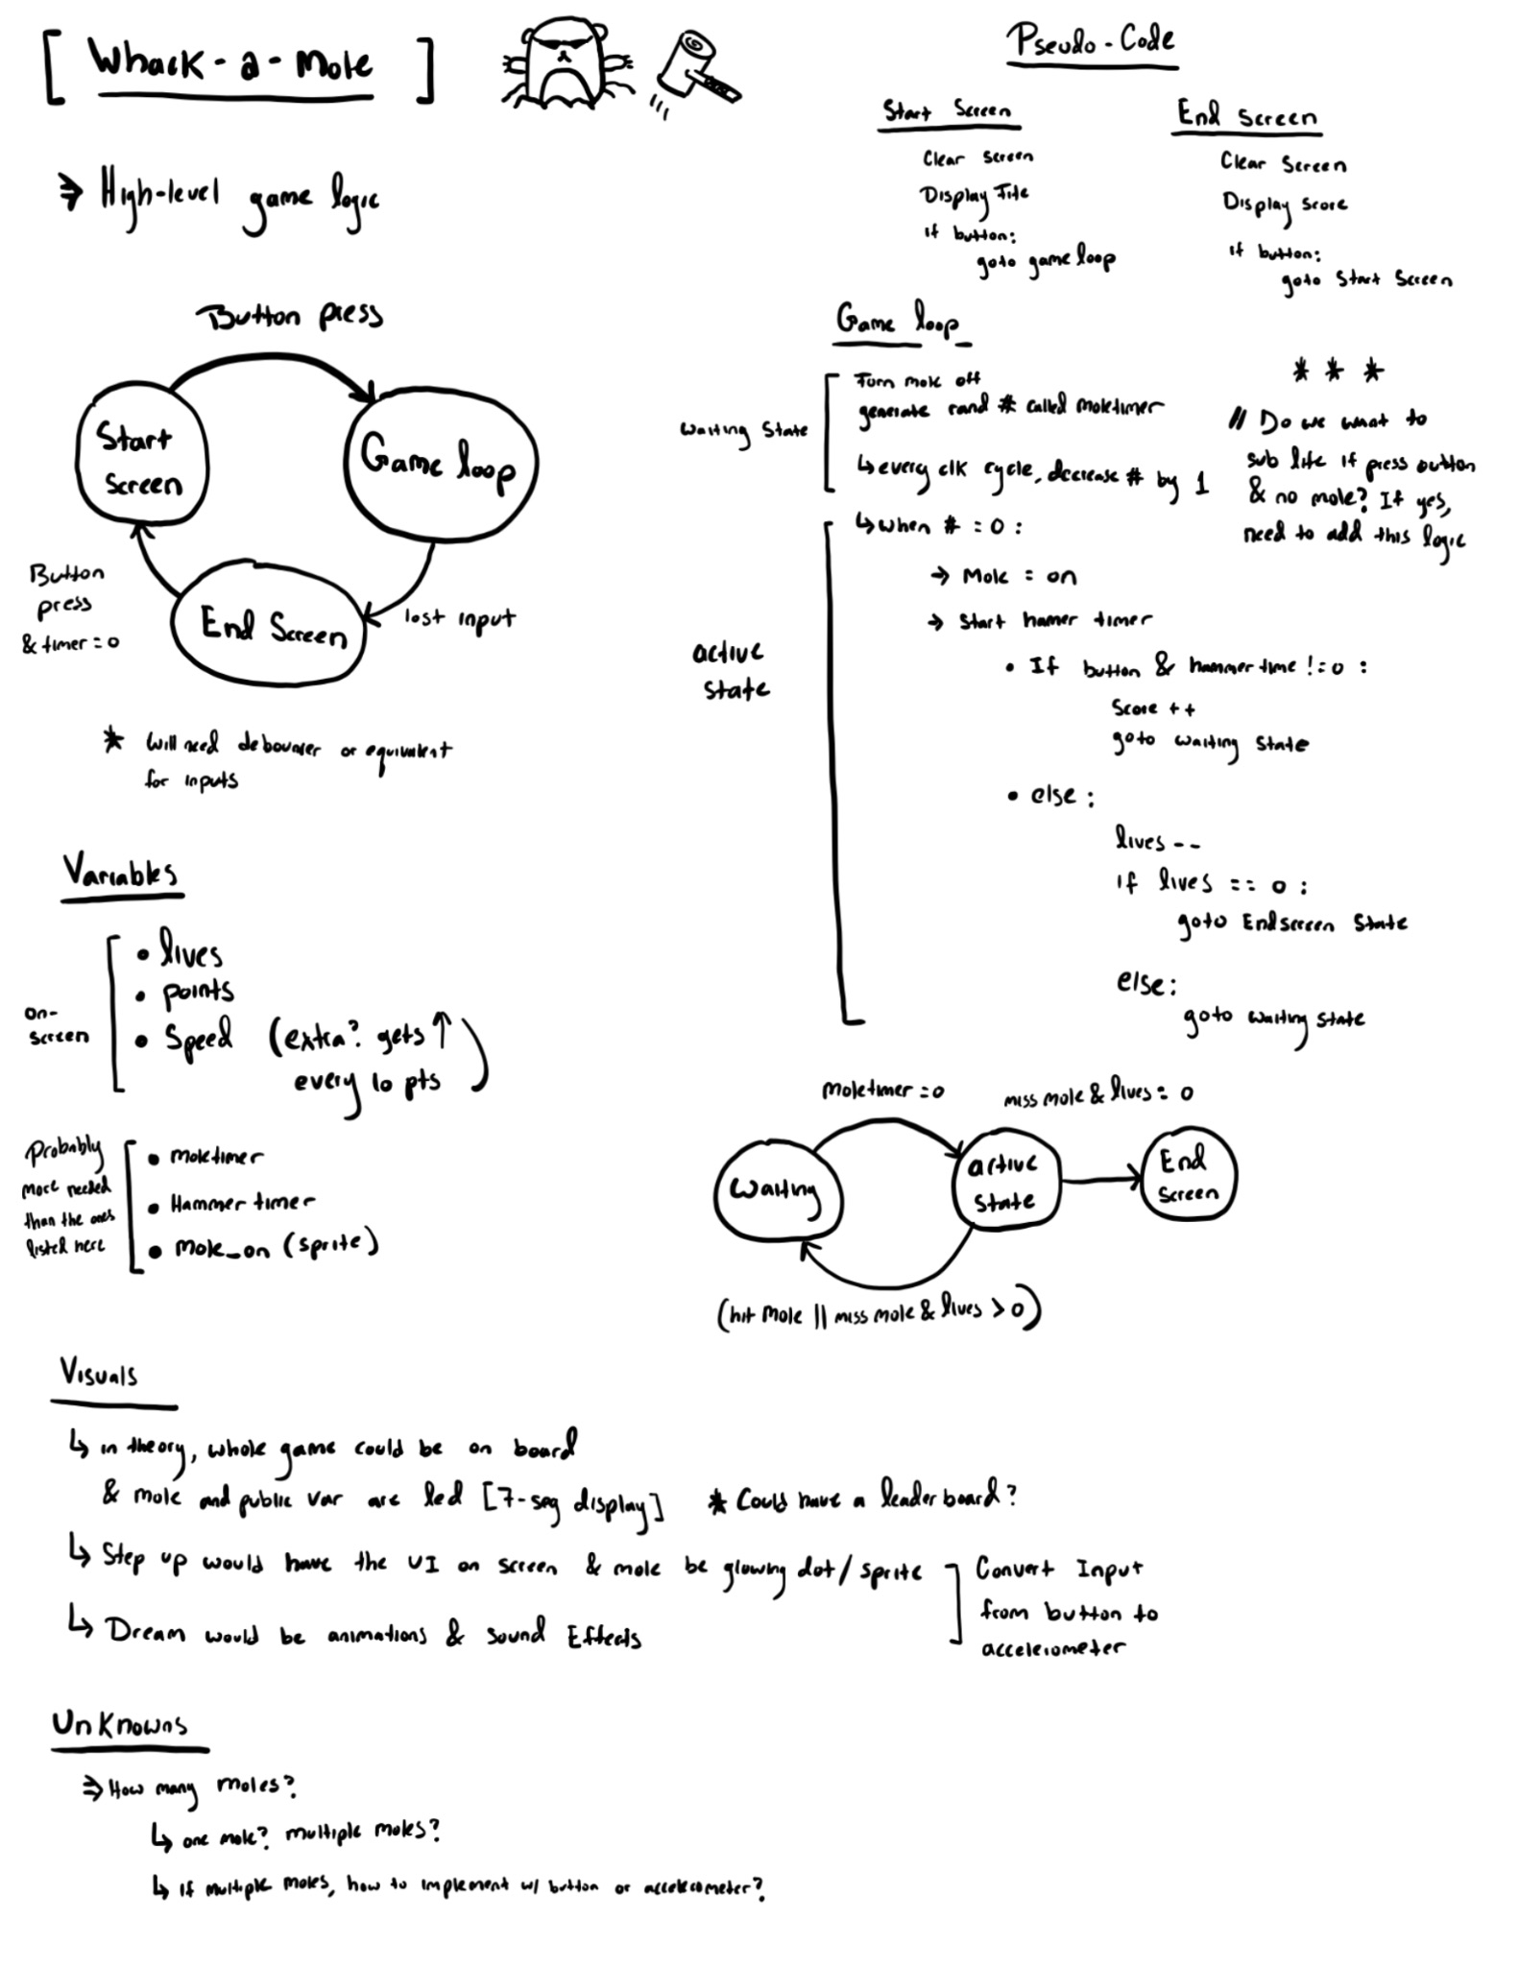
Design Doc
Red: FSM
Blue: Logic Pseudo-code
Green: Input, Output, Var.
Purple: Visuals
Yellow: Unknowns
Notes:
Red: FSM regarding game loop. Originally one button that lets you go through all states (along with reset but..) Some changes; start button to go from idle to game. Game you can only die to go to end game. Endgame -> reset = gameplay.
Blue: game Logic Pseudo-code go more in depth later
Green: Input, Output & timers for the whack a mole
Purple: Visuals/UI/ possibly sounds in the future
Yellow: Unknowns/ things we might implement later = multiple moles

Slide 12
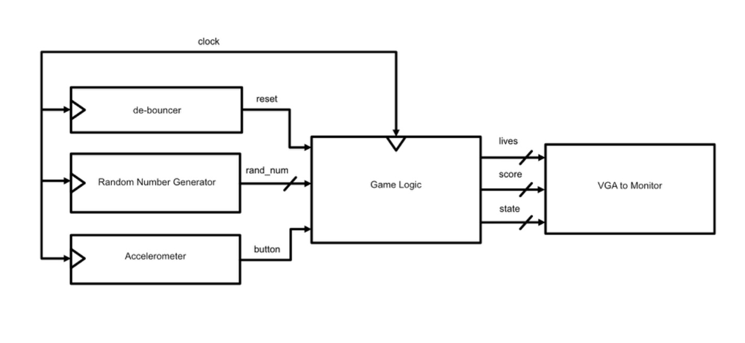
Block Diagram
Notes:
Ideal final block diagram
Deb ounces for reset, random number generator for the mole timer, accelerometer for game tilt, game logic and vga for graphics

Slide 13
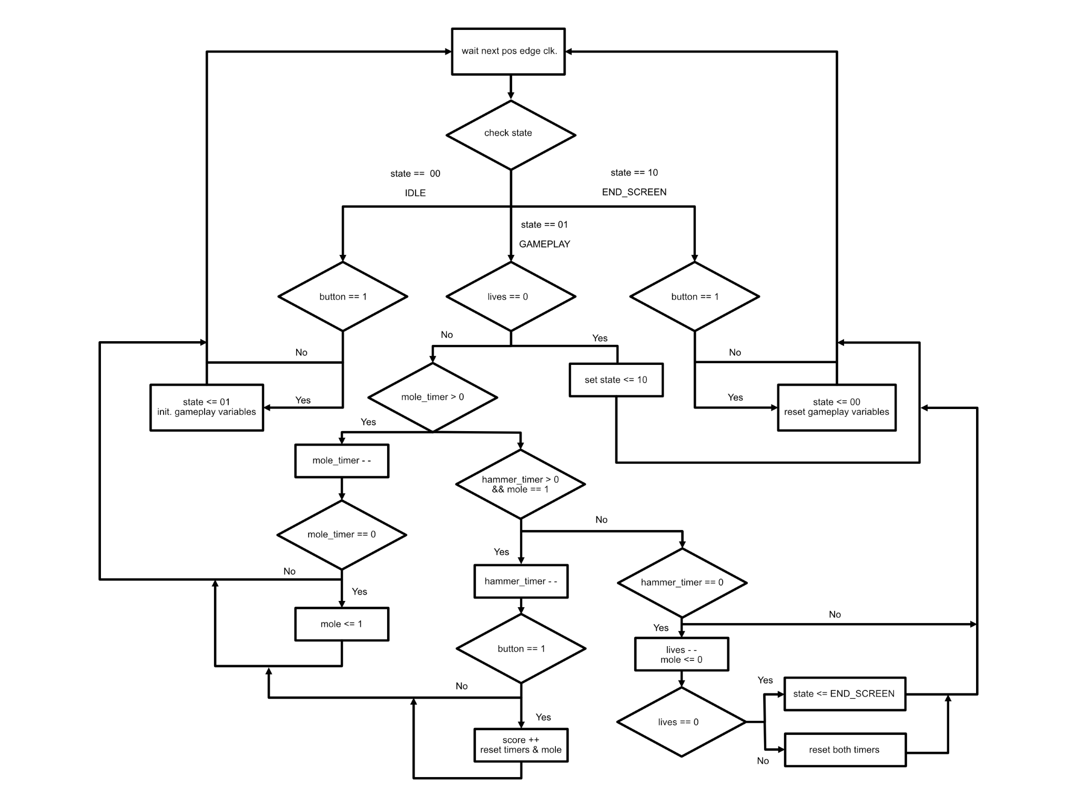
Game Logic Diagram

Slide 14
Code Snippet

Slide 15
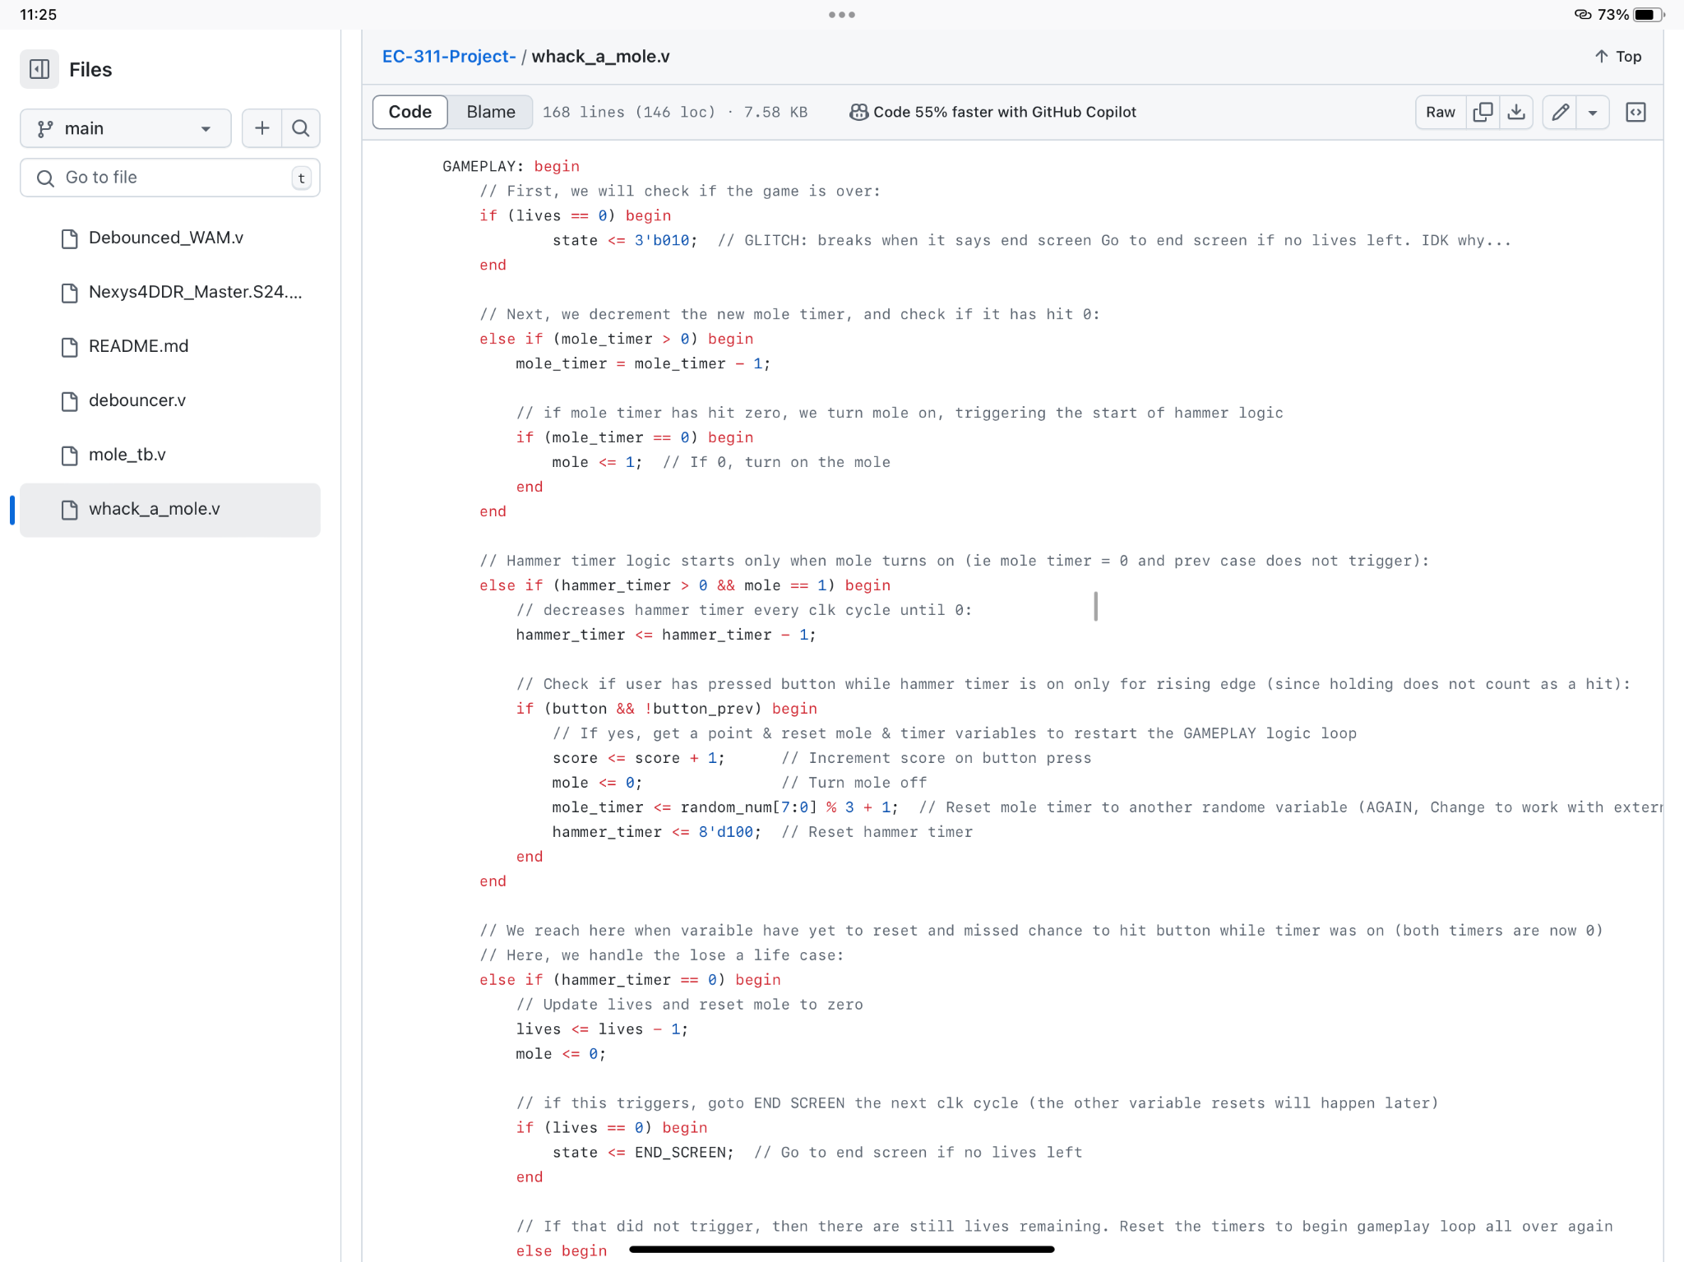
*** Key Take-away:
Timers as
State Transition Conditions (Lab 2 + 3)

Slide 19
Two Notable Design Features

Slide 20
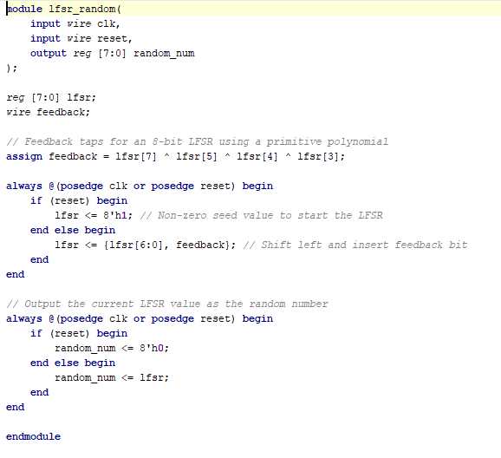
RNG Module
Responsible for random show up of mole

Slide 21
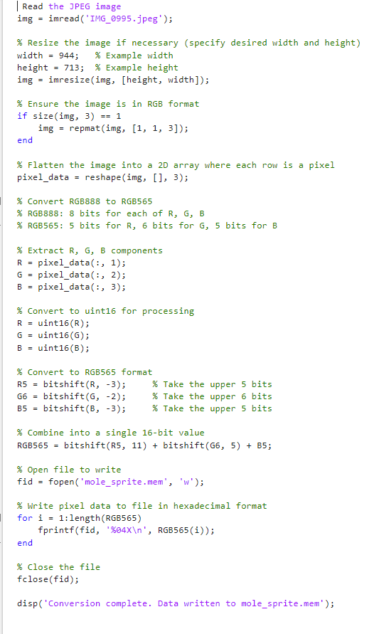
MATLAB Converter

Slide 22


Original
Bitmap Back to JPEG
Bitmap MEM file

Slide 23






Preliminary 64x64 Sprites
(not yet written in Verilog)
Thus, planned 256x320 aspect ratio
(or something close)

Slide 24
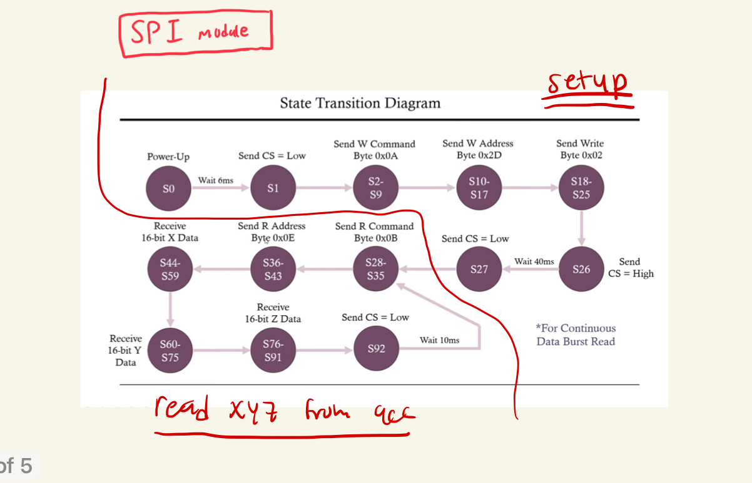
Accelerometer
FPGA —-> Accelerometer? SPI (serial peripheral interface)
Notes:
-How does the fpga communicate with accelerometer? SPI;
- SPI module: setup and burst read (sourced from YouTube video)
- setup allows us to change sensor to measurement mode from standby and start reading data
- 40 ms kind of transition state to wait data to be ready
- rest of instructions let us read xyz from data in a continuous loop
Aside from this: need to implement so much more of the code

Slide 25
Accelerometer going forward
get tilts to work (debouncer module for tilts)
Connect tilt to button (forward tilt = front button)
When all is done, Not show xyz values on 7segment display (used for testing)

Slide 26
Successes?

Slide 27

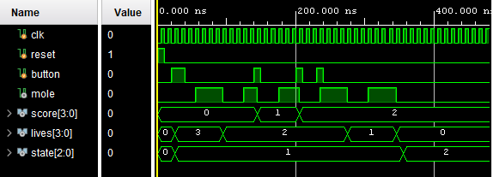
We have a hardware only version of the game working on the FPGA by itself
✅ Playable on FPGA
✅ Working Testbench

Slide 28
Failures?

Slide 29
Next Steps…
Expanding Core Game Logic → playing with more than one mole
Tying the separate modules together:
Connecting the Accelerometer as an alternative input
Implementing Random Number Generators
Creating VGA Modules to load and display bitmap data

Slide 30
Thank you for Listening.
Questions?

